Slide 1


Instagram User Analytics
By Stan Pereira

Slide 2
Project Description
Project Description
As a data analyst working with the product team at Instagram, I was tasked with analysing user interactions and engagement with the Instagram app to provide valuable insights that can help the business grow.
The user analysis involves tracking how users engage with a digital product, and the insights derived from this analysis will be used by various teams within the business.
The marketing team might use these insights to launch a new campaign, the product team might use them to decide on new features to build, and the development team might use them to improve the overall user experience.

Slide 3
Approach
The initial step is the creation of the database & tables, along with importing the data into the tables. This is achieved by running the DDL & DML SQL queries provided in MySQL through the MySQL Workbench.
After the previous step, analysis on the data was made and insights were generated from the database by running SQL queries in MySQL Workbench.

Slide 4
Tech Stack Used
The Software and Version Utilized
MySQL Workbench 8.0 CE - Version 8.0.34 build 3263449 CE (64 bits) Community
MySQL has a feature rich RDBMS that can be used to perform various data manipulation and analysis tasks such as data aggregation, table joining, data transformation, data visualization, etc.
It is also fast and scalable, allowing you can handle large amounts of data and perform complex queries efficiently.
MySQL is free and open source
MySQL supports multiple languages and platforms and different operating systems. You can also use various connectors and drivers to access MySQL.

Slide 5
Management Queries
Marketing Analysis
Loyal User Reward: The marketing team wants to reward the most loyal users, i.e., those who have been using the platform for the longest time.
Inactive User Engagement: The team wants to encourage inactive users to start posting by sending them promotional emails.
Contest Winner Declaration: The team has organized a contest where the user with the most likes on a single photo wins.
Hashtag Research: A partner brand wants to know the most popular hashtags to use in their posts to reach the most people.
Ad Campaign Launch: The team wants to know the best day of the week to launch ads.
Investor Metrics
User Engagement: Investors want to know if users are still active and posting on Instagram or if they are making fewer posts.
Bots & Fake Accounts: Investors want to know if the platform is crowded with fake and dummy accounts.

Slide 6
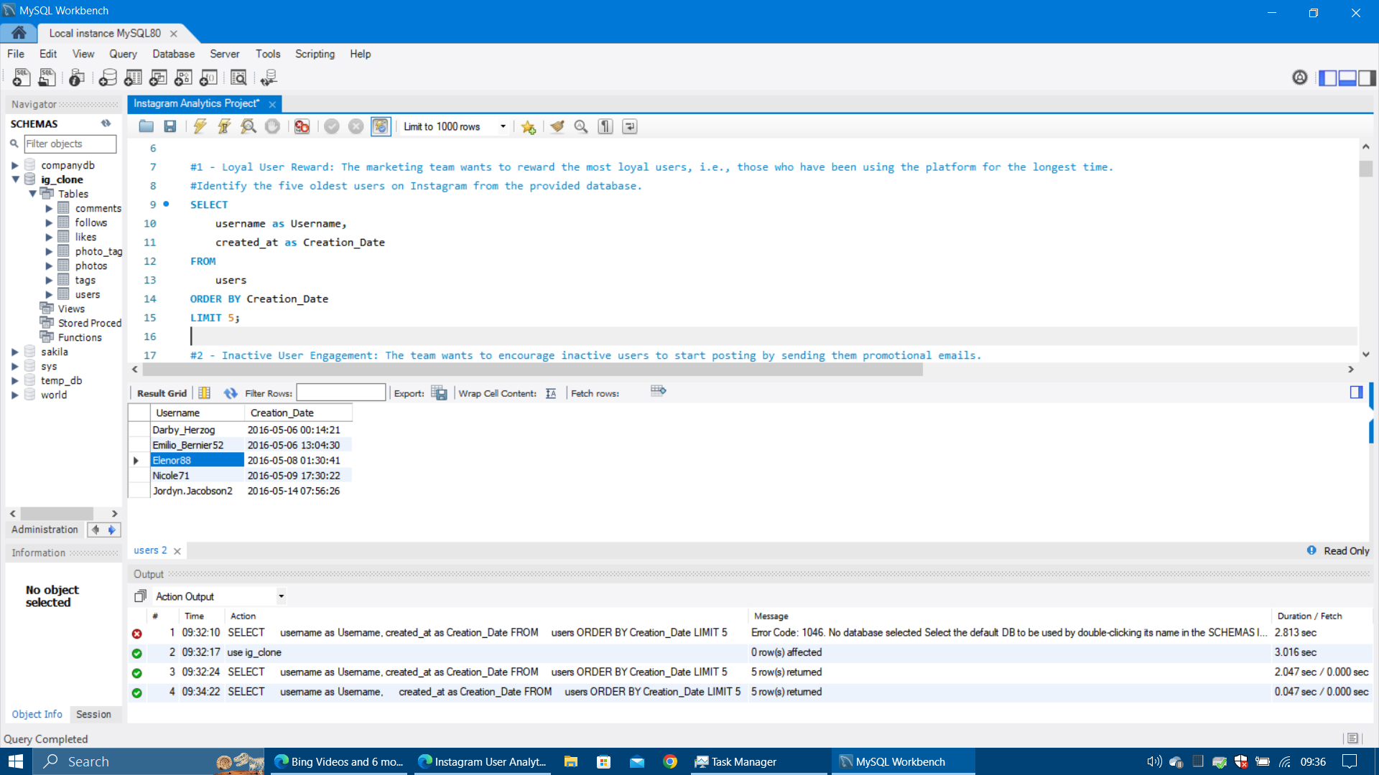
Marketing Analysis #1
Loyal User Reward: The marketing team wants to reward the most loyal users, i.e., those who have been using the platform for the longest time.
Task: Identify the five oldest users on Instagram
SQL Query:
SELECT
username as Username,
created_at as Creation_Date
FROM
users
ORDER BY Creation_Date
LIMIT 5;
Insight: The marketing team should reward those who have been using the platform for the longest time, including the user 'Darby_Herzog' who has not posted anything. It may entice him to post something.

Slide 7
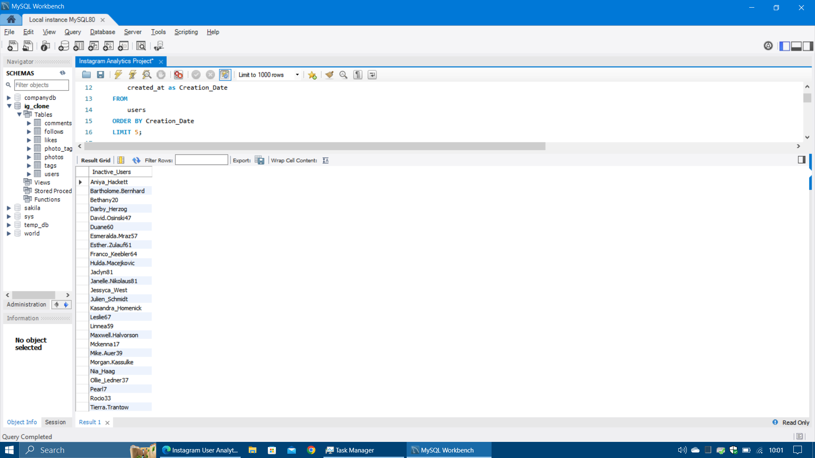
Marketing Analysis #2
Inactive User Engagement: The team wants to encourage inactive users to start posting by sending them promotional emails.
Task: Identify users who have never posted a single photo on Instagram.
SQL Query:
SELECT username as Inactive_Users
FROM
users
LEFT JOIN
photos ON users.id = photos.user_id
WHERE photos.user_id IS NULL
ORDER BY Inactive_Users;
Insight: The marketing team should encourage the 26 users to start posting by sending them promotional emails. Follow-ups can also be made, so as to remove users who are still inactive.

Slide 8
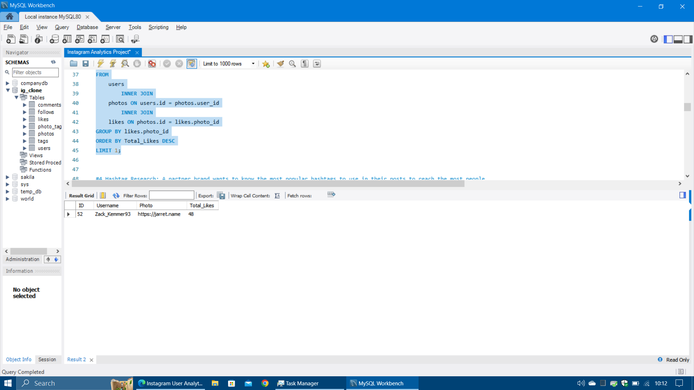
Marketing Analysis #3
Contest Winner Declaration: The team has organized a contest where the user with the most likes on a single photo wins.
Task: Determine the winner of the contest and provide their details to the team.
SQL Query:
SELECT
users.id AS ID, users.username AS Username,
photos.image_url AS Photo,
COUNT(likes.photo_id) AS Total_Likes
FROM
users
INNER JOIN
photos ON users.id = photos.user_id
INNER JOIN
likes ON photos.id = likes.photo_id
GROUP BY likes.photo_id
ORDER BY Total_Likes DESC
LIMIT 1;
Insight: The user 'Zack_Kemmer93' has got the most likes (48) for one of his photos. All users should be informed of the contest winner and his photo. A small reward needs to be given to winner, which might entice other users to post more.

Slide 9
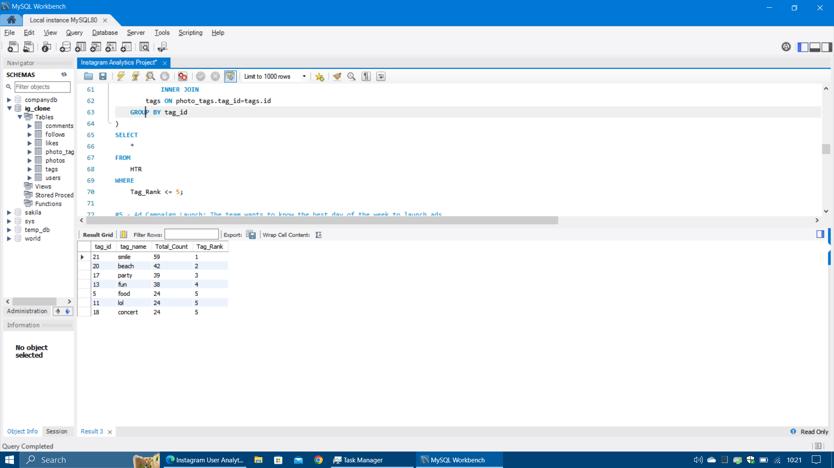
Marketing Analysis #4
Hashtag Research: A partner brand wants to know the most popular hashtags to use in their posts to reach the most people.
Task: Identify and suggest the top five most commonly used hashtags on the platform.
SQL Query:
WITH HTR as (
SELECT
tag_id, tag_name,
COUNT(tag_id) as Total_Count,
RANK() OVER (ORDER BY COUNT(tag_id) DESC) as Tag_Rank
FROM
photo_tags
INNER JOIN
tags ON photo_tags.tag_id=tags.id
GROUP BY tag_id
)
SELECT *
FROM
HTR
WHERE
Tag_Rank <= 5;
Insight: Even though the top five hashtags were asked for, the hashtag that was ranked 5th was tied with two others, hence a total of 7 hashtags are mentioned.

Slide 10
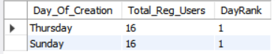
Marketing Analysis #5
Ad Campaign Launch: The team wants to know the best day of the week to launch ads.
Task: Determine the day of the week when most users register on Instagram. Provide insights on when to schedule an ad campaign.
SQL Query:
WITH DayTable as (
SELECT
DAYNAME(created_at) as Day_Of_Creation,
COUNT(DAYNAME(created_at)) as Total_Reg_Users,
RANK() OVER (order by count(dayname(created_at)) DESC) as DayRank
FROM
users
GROUP BY Day_Of_Creation
)
SELECT *
FROM
DayTable
WHERE
DayRank=1;
Insight: There are two days of the week that have the most registrations. As the goal is to increase registrations, the marketing team may want to launch ads on both the days of most registrations, as this indicates that there is a high demand and interest.

Slide 11
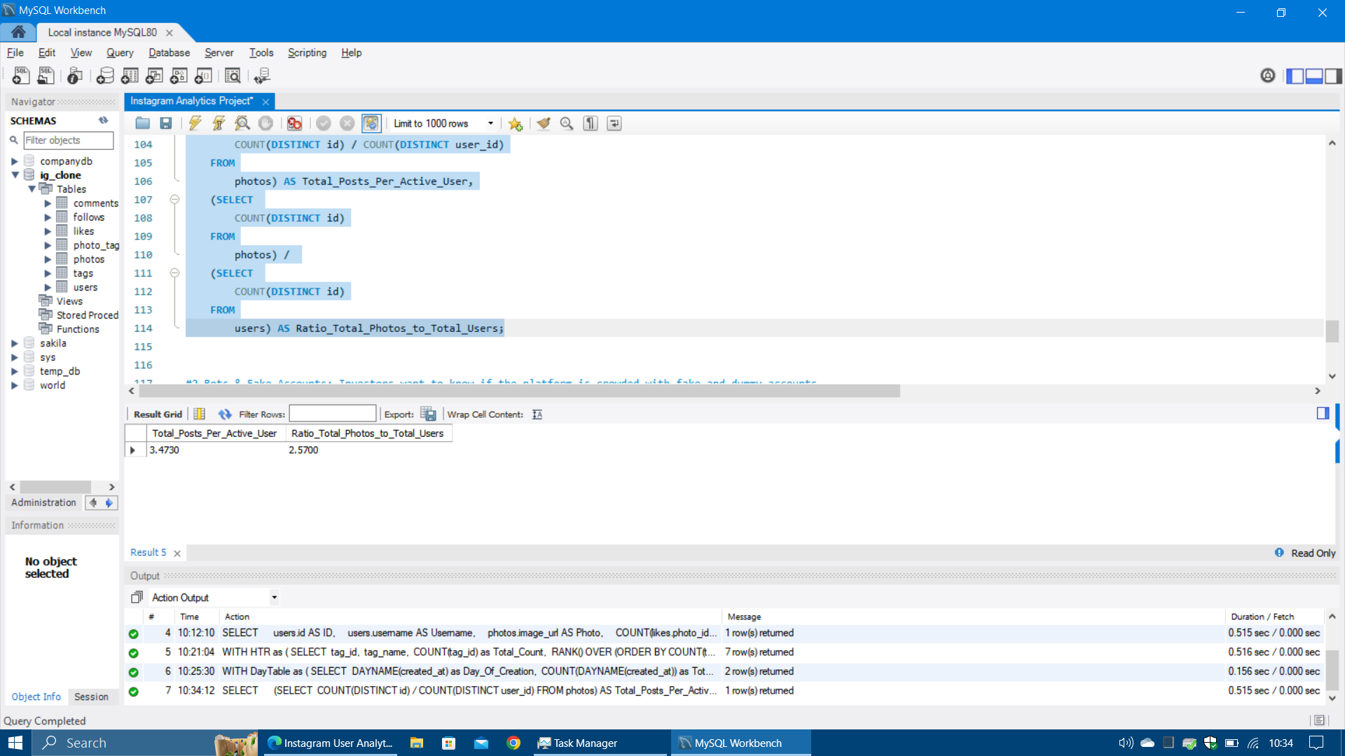
Investor Metrics #1
User Engagement: Investors want to know if users are still active and posting on Instagram or if they are making fewer posts.
Task: Calculate the average number of posts per user on Instagram. Also, provide the total number of photos on Instagram divided by the total number of users.
SQL Query:
SELECT
(SELECT
COUNT(DISTINCT id) / COUNT(DISTINCT user_id)
FROM
photos) AS Total_Posts_Per_Active_User,
(SELECT
COUNT(DISTINCT id)
FROM
photos) /
(SELECT
COUNT(DISTINCT id)
FROM
users) AS Ratio_Total_Photos_to_Total_Users;
Insight: The Average number of posts is taken from Active Users, but the ratio is taken from All Users. The information shows the gap between the users that are registered and actual users making posts. This gap needs to decrease.

Slide 12
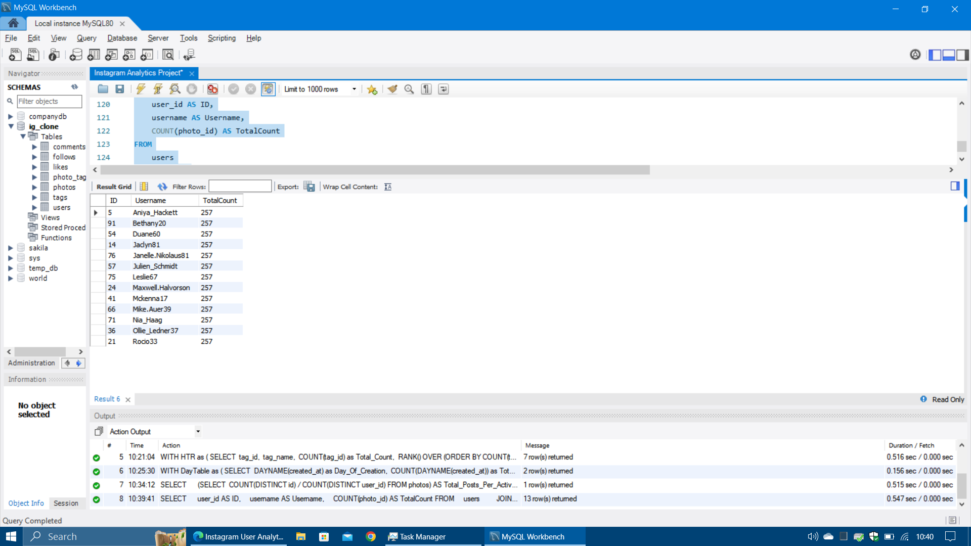
Investor Metrics #2
Bots & Fake Accounts: Investors want to know if the platform is crowded with fake and dummy accounts.
Task: Identify users (potential bots) who have liked every single photo on the site.
SQL Query:
SELECT
user_id AS ID, username AS Username,
COUNT(photo_id) AS TotalCount
FROM
users
JOIN
likes ON users.id = likes.user_id
GROUP BY user_id
HAVING TotalCount = (SELECT
COUNT(id)
FROM
photos)
ORDER BY username;
Insight: As genuine users do not normally like every single photo, the 13 users in the list are Bots or Fake Accounts. This list distorts the data and can provide incorrect analysis. The users need to be removed from the database.

Slide 13
Project Impact
Impact for the Team
The analysis from the data will help the product manager and the team make informed decisions about the future direction of the Instagram App.
Impact for Me
The project allowed me to learn the fundamentals of SQL and its working. It has also shown me how to use it to extract various insights for data analysis.

Slide 14

Thank You

